Slide 1
Big Data Engineering
Introduction
Julie Weeds
March 2020

Slide 2
Contents
Definitions
Origins of Big Data
Case Studies and Motivations

Slide 3
Big Data definition
Data of a very large size, typically to the extent that its manipulation and management present significant logistical challenges
Oxford English Dictionary

Slide 4
So what is Big Data?
Big data is high-volume, high-velocity and high-variety information assets that demand cost-effective, innovative forms of information processing for enhanced insight and decision making (source: Gartner glossary)

Slide 5
The three Vs
Velocity
Need to be able to process data faster
Handle very large numbers of data elements/sec incoming
Variety
Not just the same old columns
New formats, new sources, new details
Volume
Massive volumes are becoming normal
Collecting the next level of data
E.g. Bank Trades, Website interactions, shopping experiences, etc

Slide 6
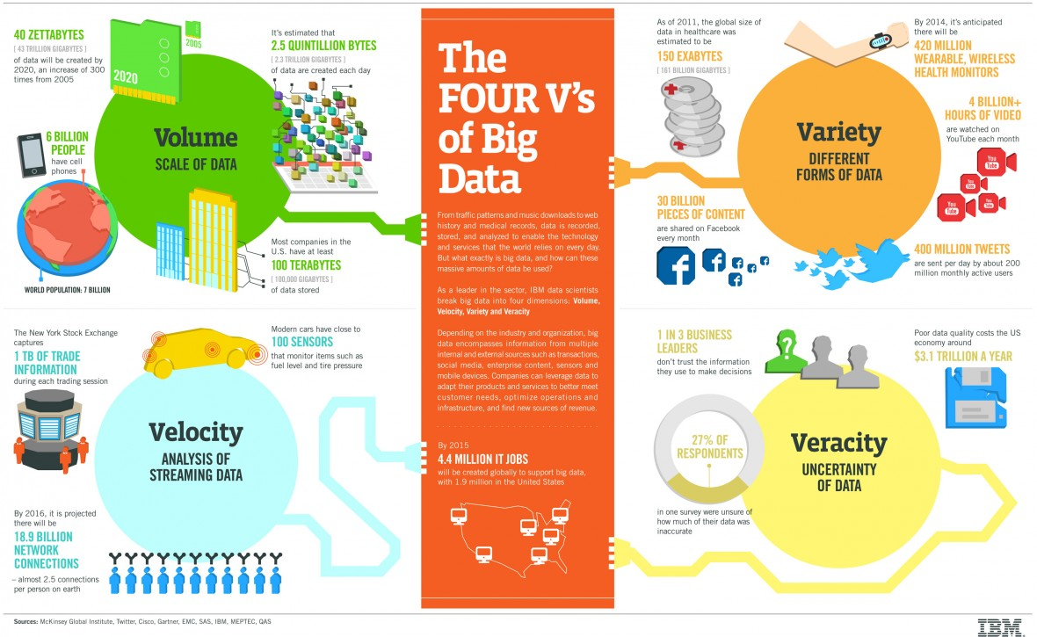
The four Vs (IBM)

Slide 7
My Big Data definition
Any data storage and analysis that:
Cannot be processed on a single machine in a timely manner
Over time needs more computation and resources than a fixed size system can provide

Slide 8
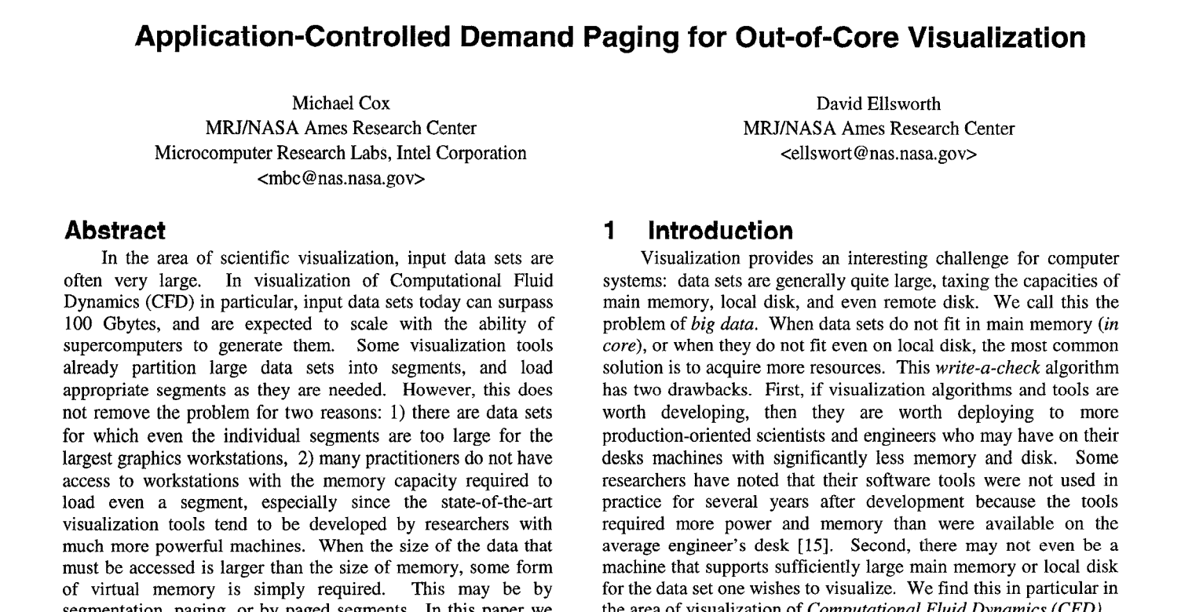
Origins of Big Data - 1997

Slide 9
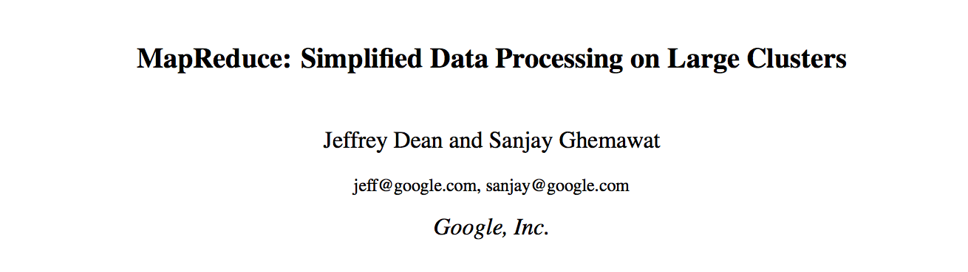
Map Reduce 2008

Slide 10
Master Data
One widely used approach
You ingest core data and never change it
You can create summaries, cleaned data, etc
But the original data is immutable
Cheap disk space…

Slide 11
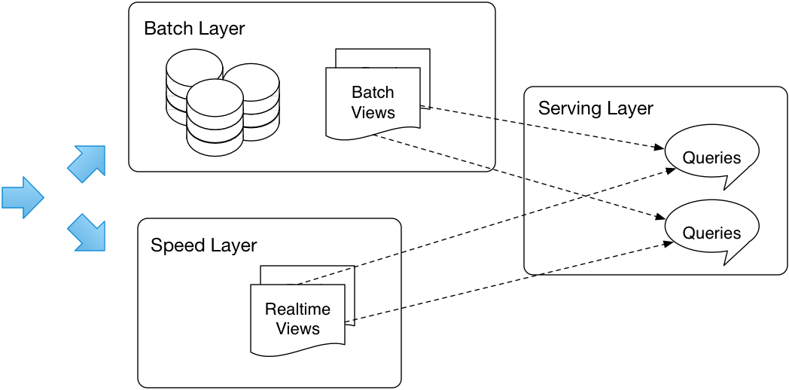
Lambda Architecture

Slide 12
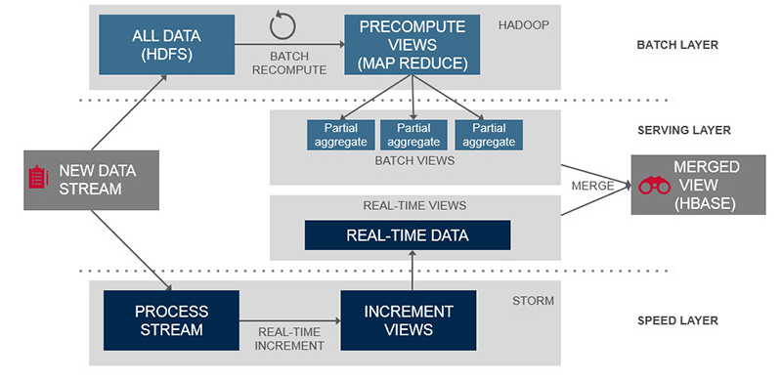
Lambda Architecture (MapR)

Slide 13
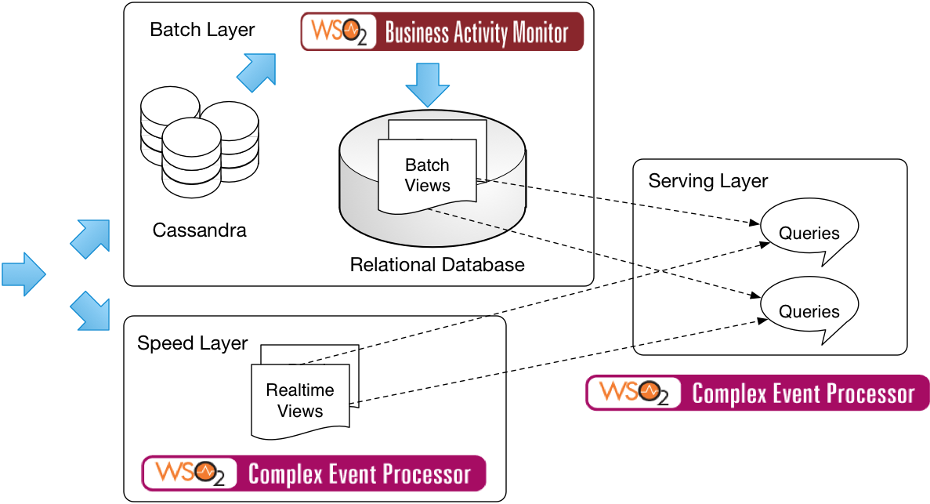
Lambda Architecture instantiation (WSO2)

Slide 14
Big Data technologies
Map Reduce
Hadoop, Spark, etc
In-Memory Directed Acyclic Graphs
Spark, Tez
Realtime Stream processing
Spark, Storm, Siddhi
NoSQL
Cassandra, Mongo, CouchDB, etc
Statistical Analysis
R, SparkR, MapR
Machine Learning
Mahout, MLlib, TensorFlow

Slide 15

Why Python?

Slide 16
Python for Big Data
Python is a great language for Data Science
NumPy, Pandas, many graphic packages
Python is a great language for Spark
Lambdas, concise statements, DataFrames
Ipython/Jupyter is a great notebook

Slide 17
Other options
C/C++ are fast to run, but generally slow to develop
Scala is an even better language for Spark
But not so strong in wider data science
Java is too wordy for Data Science!
R is a great model for both Data Science and Spark, if you are a statistician
Julia might be a great option in the future … but not widely adopted yet
Do not even consider Perl ;-)

Slide 18
Notebooks
Web-based systems that combine documentation, code and graphics into one place
Two front runners for Big Data
Jupyter (formerly IPython)
Based on Python but supporting other languages
Apache Zeppelin
More language neutral but newer and more buggy (this may be changing of course)

Slide 19
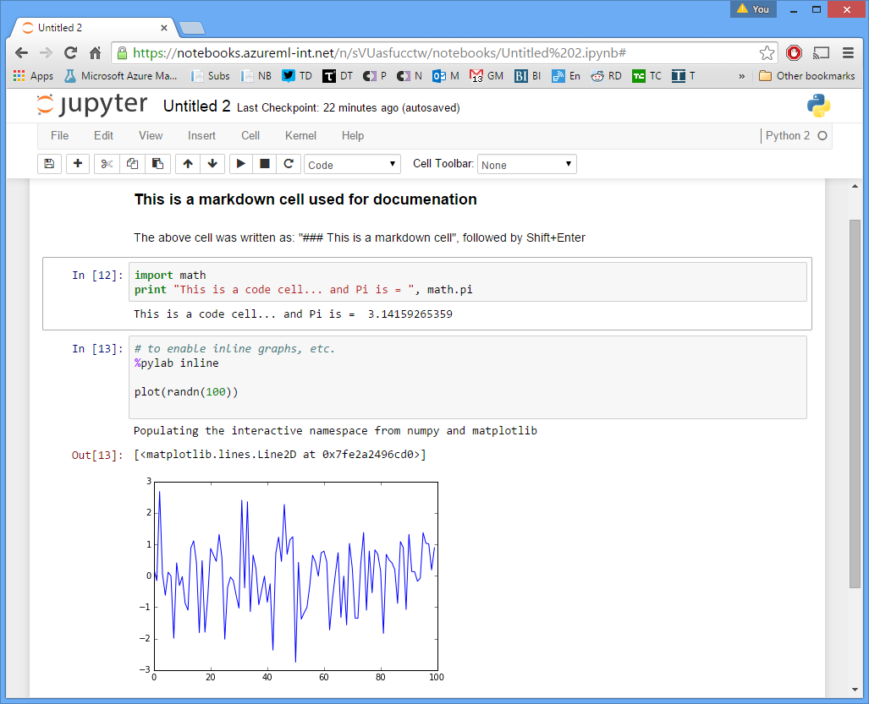

Slide 20
Numpy
>(sudo) pip install numpy
Numerical and scientific analysis library in Python
Foundation of most data analysis in Python
Based on arrays of data

Slide 21
Base ecosystem
scipy
pandas
matplotlib
numpy

Slide 22
Pandas
A rich relational data model built on top of Python’s numpy
Emerged from the finance industry
Like R’s data.frame (but maybe better?)

Slide 23
Matplotlib
A simple graphing library for Python
Works well with Pandas and Numpy
Integrated into Jupyter
There are many alternatives
E.g. Bokeh, seaborn

Slide 24
This course
Python
pandas
matplotlib
pyspark
Apache Spark with Python
Jupyter
Some other libraries etc as we go

Slide 25
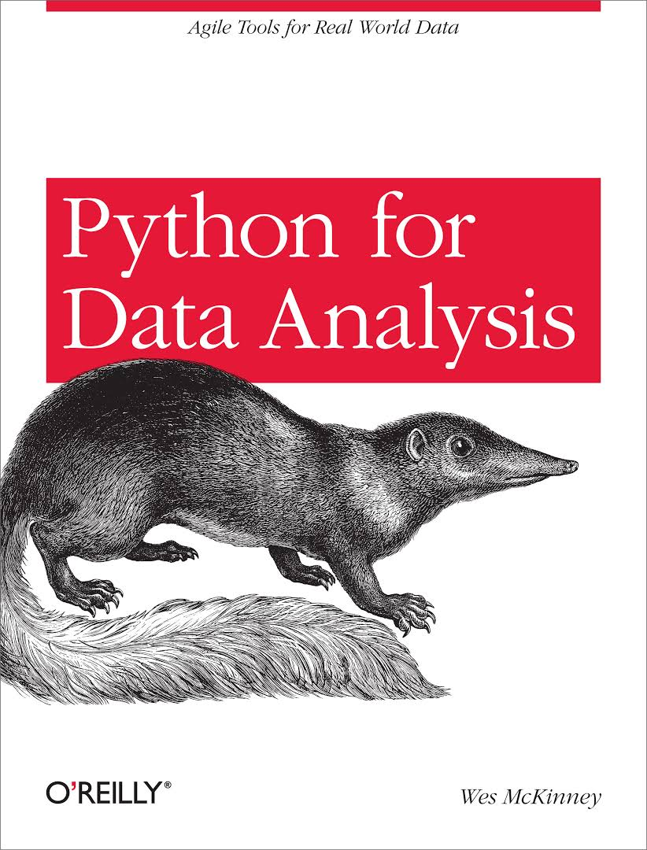
Recommended
Reading!

Slide 26
Case studies

Slide 27
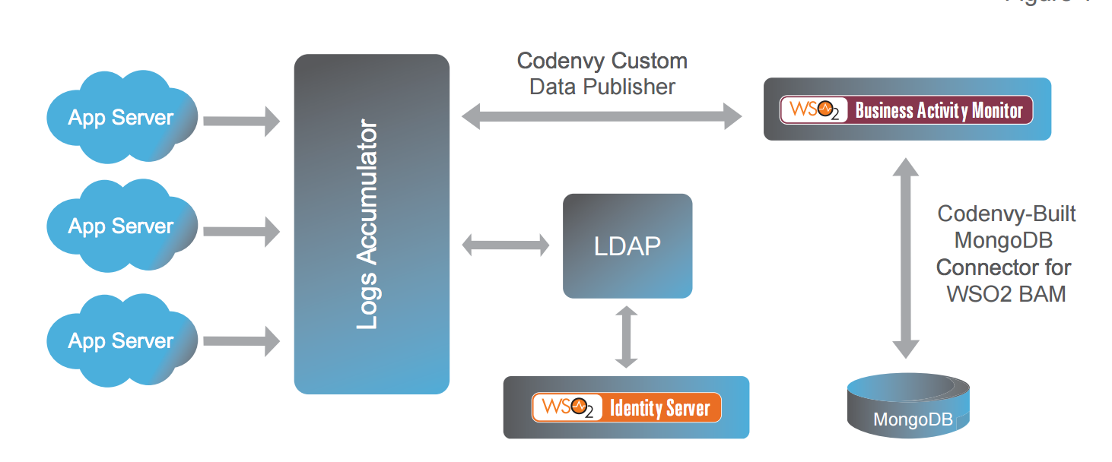
Big Data Cloud management analytics

Slide 28
Realtime Big Data
New York-based Bank
25 servers in a cluster analysing trading and system data from operational systems
Siddhi-based engine processing data in realtime
Handling 10,000s of events/second

Slide 29
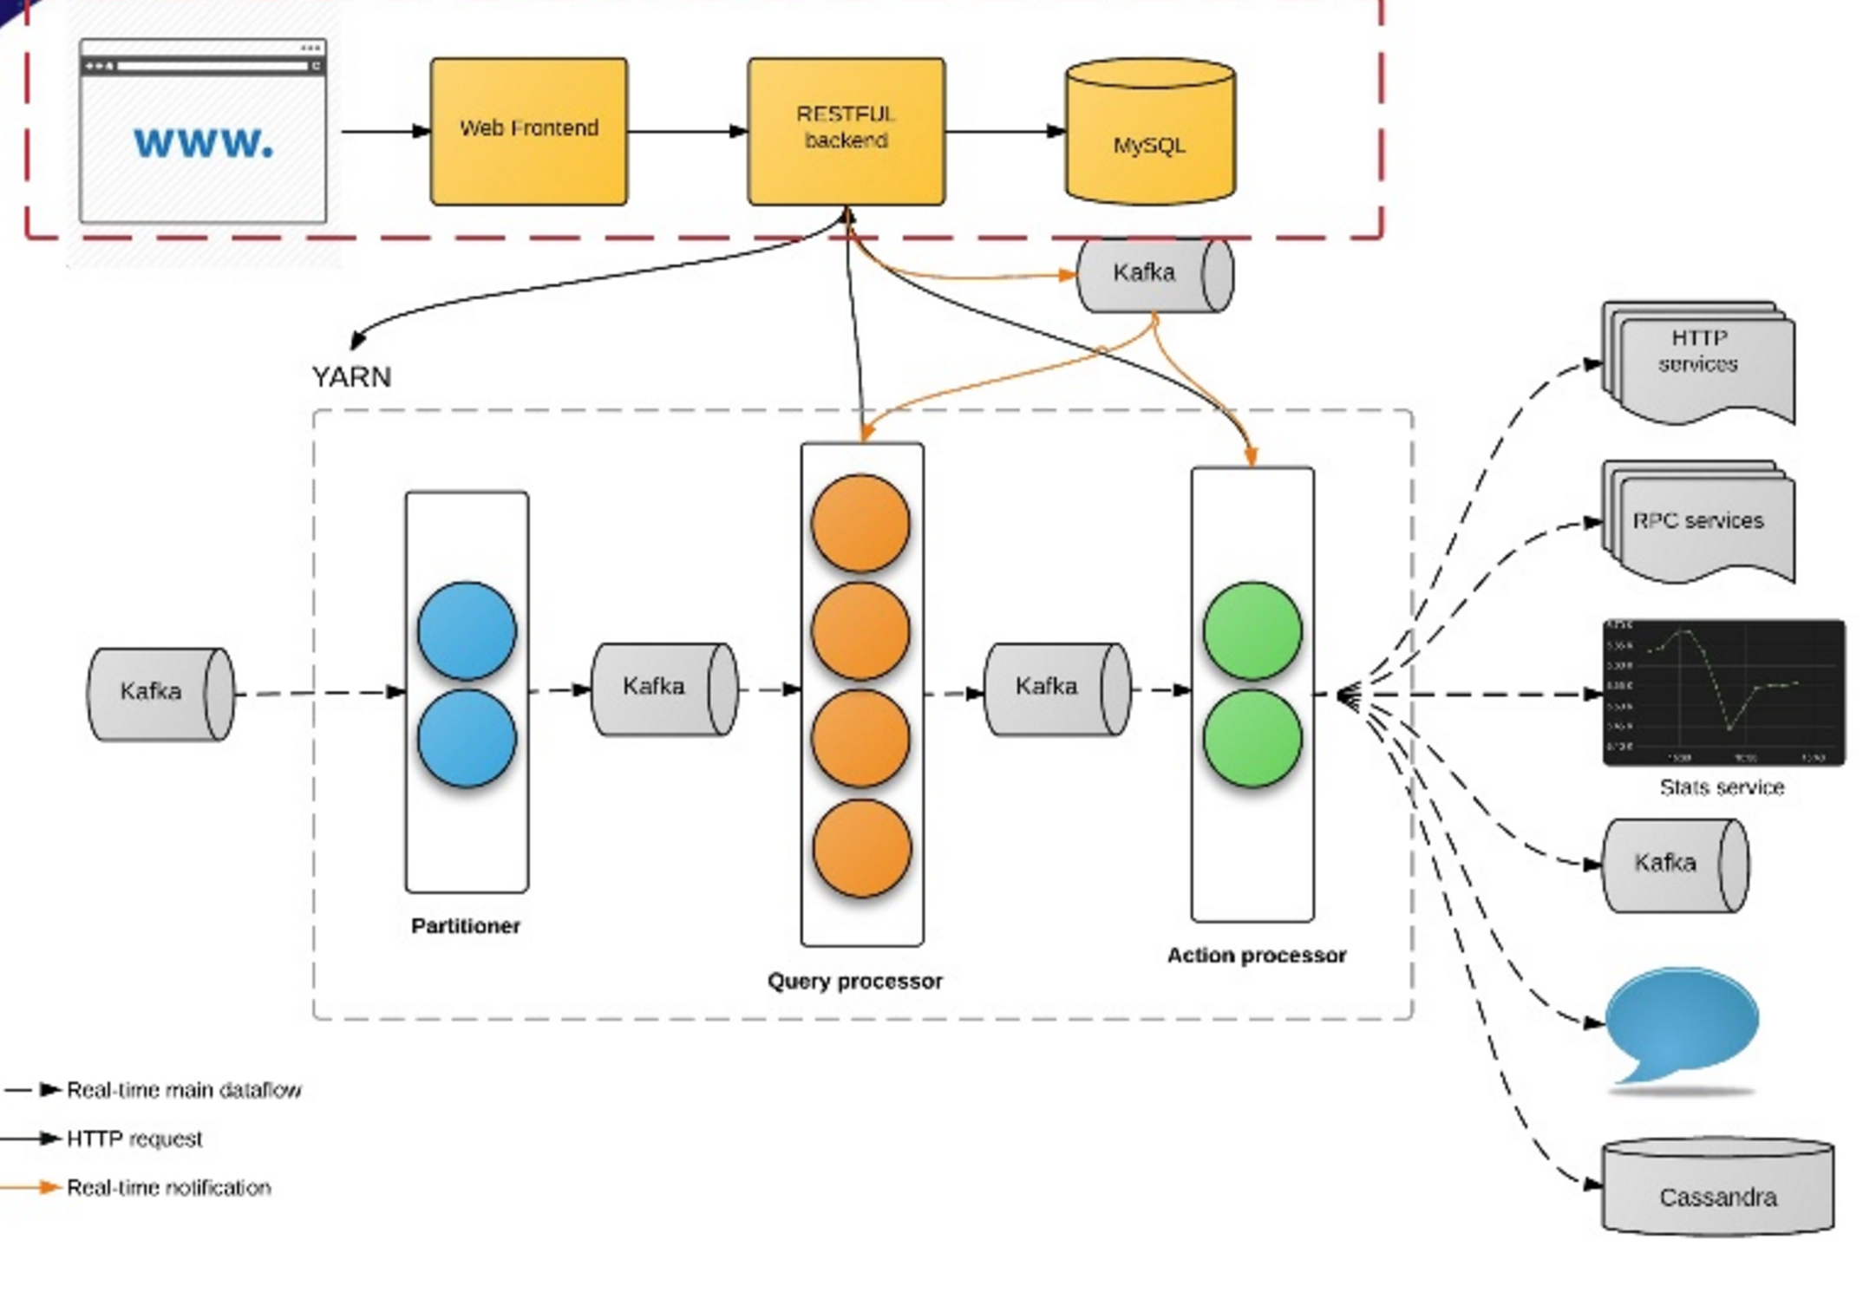
Realtime Big Data at Uber

Slide 30
Realtime Big Data at Uber
100+ production apps
30 billion messages / day
347,000 messages / second
Fraud, anomaly detection
Marketing, promotion
Monitoring, feedback
Real time analytics and visualization
https://freo.me/siddhi-uber

Slide 31
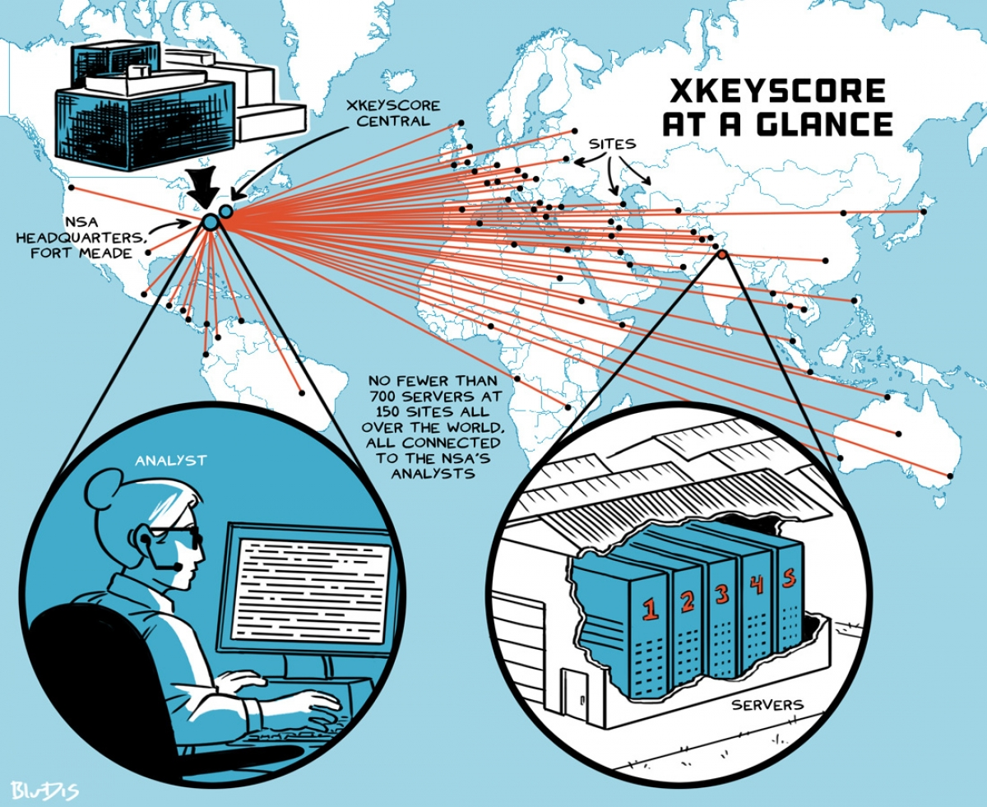
https://firstlook.org/theintercept/2015/07/01/nsas-google-worlds-private-communications/

Slide 32
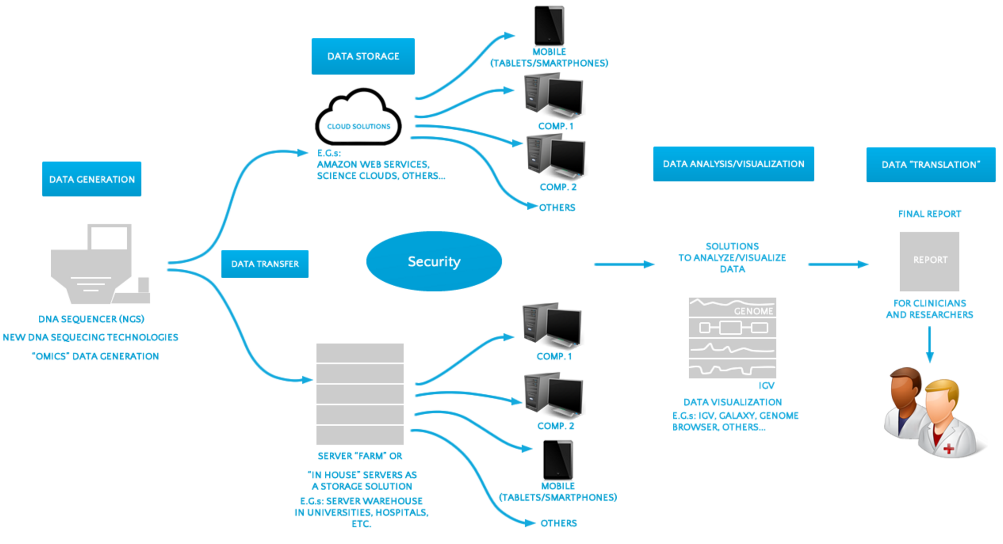
Big Data in Genomics http://www.laboratory-journal.com/science/information-technology-it/big-data-genomics-challenges-and-solutions

Slide 33
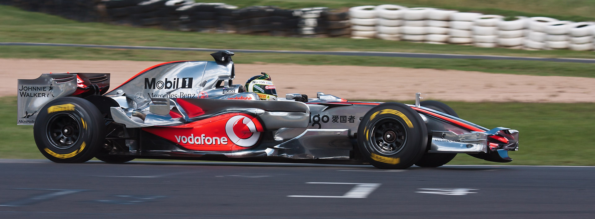
Maclaren Formula 1
Collects 1Gb/race
Analysing in real-time to tune and manage the car

Slide 34
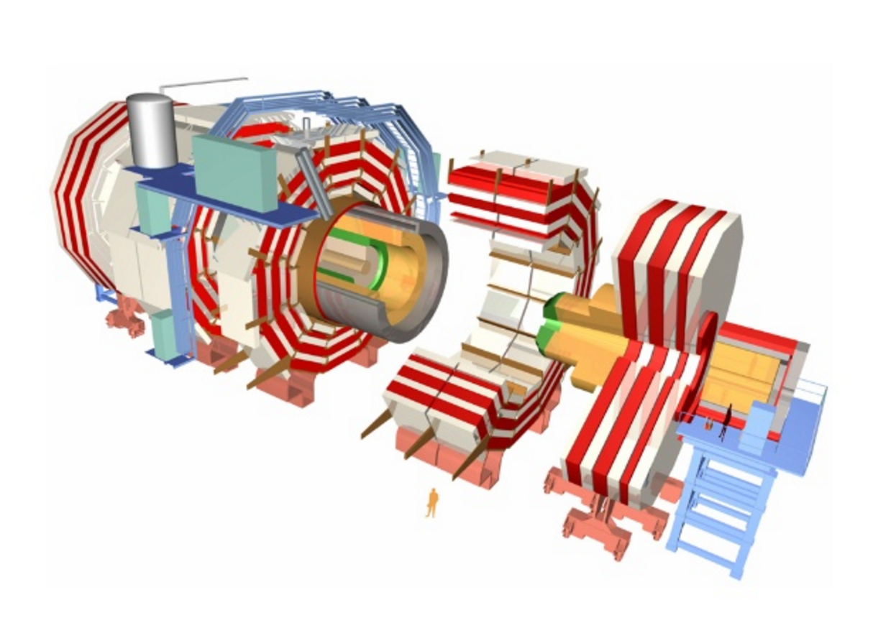
Notes:
What is this? It is the Compact Muon Solenoid at CERN – how much data does it generate?

Slide 35
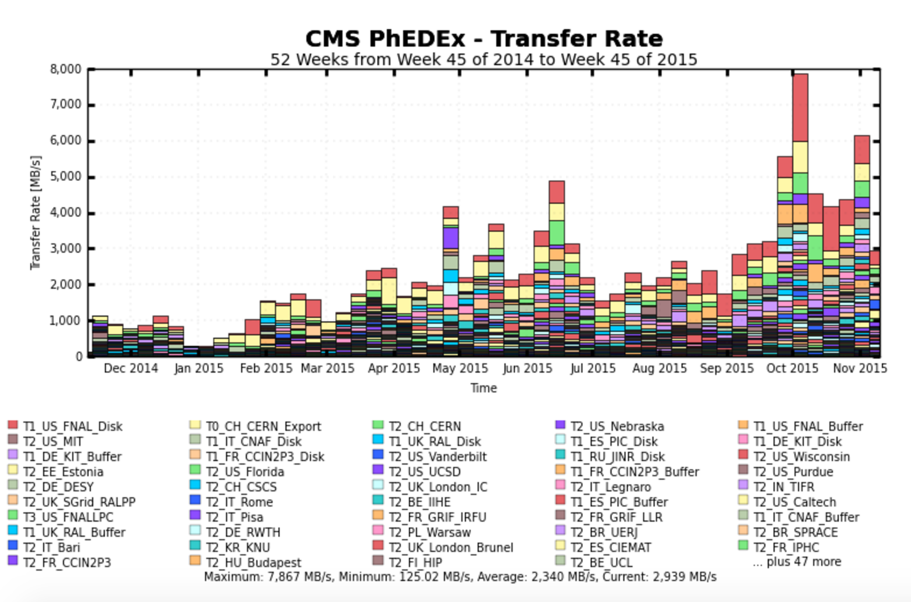
Large Hadron Collider Compact Muon Solenoid Experiment Source: http://cmsweb.cern.ch/phedex

Slide 36
Questions?

